Slide 1
Zooutopia
Website presentation
Aleena Zahra, Ayman Irshad,
Ishmal Faheem, Abdul Rafay

Slide 2
table of contents
01.
02.
03.
04.
05.
06.
Introduction of Our Website
Why we chose this domain
What problem it solves
What is our target audience
The Functionality of our site
Theme
07.
08.
Responsiveness in our site
Future direction

Slide 3
introduction
01.
Welcome to ZooUtopia’s Website – A Virtual Wildlife Adventure

Slide 4
Our Motivation
02.

Slide 5
Anatole France
“Until one has loved an animal, a part of one’s soul remains unawakened.”

Slide 6
03.
Problems
Solved

Slide 7
Problems we solve
Our website addresses key issues by offering centralized information on hours, tickets, exhibits, and events. It promotes the zoo through photos, and interactive content, attracting more visitors.
Online ticketing streamlines entry, and educational resources enhance the learning experience. The site also spotlights conservation initiatives, fostering awareness and support
.The site has the ability to accept donations for conservation programs, contributing to wildlife preservation.

Slide 8
Target Audience
04.

Slide 9
Our target audience includes kids, wildlife enthusiast, families and students
z
ALL Animal LOVErs

Slide 10
Functionality
05.

Slide 11
Functionality
Homepage
About Us
User Engagement
Visitor Information
Educational Programs
Events Page
Captivating with dynamic visuals
Informs users about the zoo
Donation, feedback, login, and support
Schedules and special services for convenience
Showcasing the zoo's commitment to learning
Highlights upcoming events
Contact Us Form
Ticketing System
User-friendly for effective communication
Simplifies entry for visitors

Slide 12
06.
Theme
We chose the Theme as green and white as green represents nature and white provides a minimalistic background, just like these presentation slides.

Slide 13
07.
Responsiveness

Slide 14
Responsiveness
Back to top button
Buttons to link pages
hover
A back to top button on each page that takes the user back to the top
There are multiple buttons and links that connect the website together
Hovering over features; hovering over navbar changes color, and displays info for gallery

Slide 15
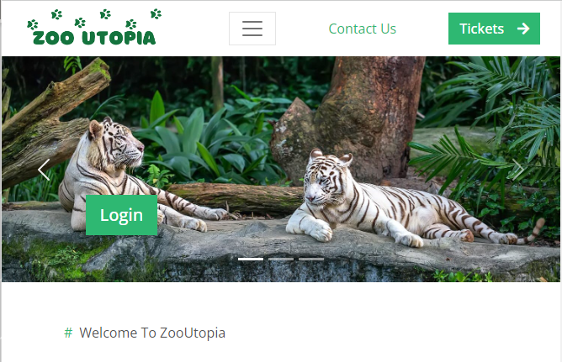
Future direction
08.

Slide 16
Future plans
We think our site could improve by adding more features.
Like a membership page and a zoomap.
In the future we would like to extend our site if we got the chance and customize it for a local zoo to help them out!

Slide 17
Thanks!
QUESTIONS?

